Slide 1
集體智慧導論
課程介紹
葉建華
jhyeh@mail.au.edu.tw
http://jhyeh.csie.au.edu.tw/

Slide 2
Course Background
課本名稱: Programming Collective Intelligence
  建議簡體版本
課程投影片網址
  http://jhyeh.csie.au.edu.tw/courses/AU.CIML.2013/course.CIML.xml
程式開發環境: Eclipse

Slide 3

Goals
We will:
  learn to program in Java with Python-based code
  survey mathematical techniques for mining the web and be able to use them in actual applications
  cover each chapter in the text book
    note that each chapter is a survey; we could spend a semester or more on every topic…

Slide 4

“集體智慧編程”

Slide 5
Administrative Details
學期課程進行中, 共會有課後程式(每一講次一次)/期中筆試/期末報告等活動
學期中各個程式均需自行寫作繳交
學期配分
  課堂表現: 30%
  隨堂作業: 30%
  期中考: 20%
  期末報告: 20%

Slide 6
Administrative Details
This is a serious programming class!
  You should be able to teach yourself Java programming from the book examples in Python
  I assume you can write a program in Java language, understand variables, control structures, functions/subroutines
You will work in teams of two people
  assignments are the same regardless of group size

Slide 7
Administrative Details
Pick teams wisely
  at any time, teams can split up, but no new teams will be formed after the first assignment is due
    no team member swaps

Slide 8
Take a Look!
http://www.youtube.com/watch?v=NLlGopyXT_g

Slide 9
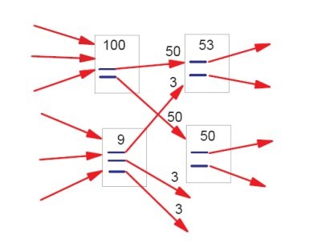

Why do we care about mining the Web?
People in aggregate can be
very smart…
  sometimes referred to as the “wisdom of crowds”
    http://en.wikipedia.org/wiki/The_Wisdom_of_Crowds
…and sometimes not.
  http://en.wikiquote.org/wiki/List_of_misquotations
  http://www.youtube.com/watch?v=h6sj89xgnl4
  (Star Wars – Luke, I am your father)
pagerank image from: http://hamletbatista.com/wp-content/uploads/2007/10/pagerank.jpg

Slide 10
What is Collective Intelligence?
Collective intelligence is a form of intelligence that emerges from the collaboration and competition of many individuals. (Wikipedia)

Slide 11
Examples of Collective Intelligence
Explicit vs. Implicit Activities
  Implicit: insight achieved inherently with no extra work from the user
  Explicit: insight requires specific activity from user

Slide 12
Common Computer-based Collective Intelligence Applications
Social Networks
Discussion Forums
Mailing Lists
Rating Systems
Tags

Slide 13
Google
Google Search
  A giant recommender system
Google Trends
  Asks: “What are people searching for?”
  Takes Google Search a step further

Slide 14
Amazon
System Activity
  Home page recommendations
  “People who bought this also purchased...”
  “Buy this with this and get an additional 5% off”
User Activity
  Item Viewing
  Purchasing
  “I Own It” Control (Yes/No)
  Rating System (1-5 Scale)
  Was this review helpful? (Yes/No)
  Tags

Slide 15
Netflix
Recommendations and the Netflix Prize
  $1,000,000 to entrant scoring 10% better than Netflix’s Cinematch recommendation system
  Began as a crowd sourcing endeavor but became a source of collective intelligence
    12/2006 – Third place entrant posted complete algorithm online
    Netflix has incorporated ideas from current leader into Cinematch
    Just a Guy in a Garage

Slide 16
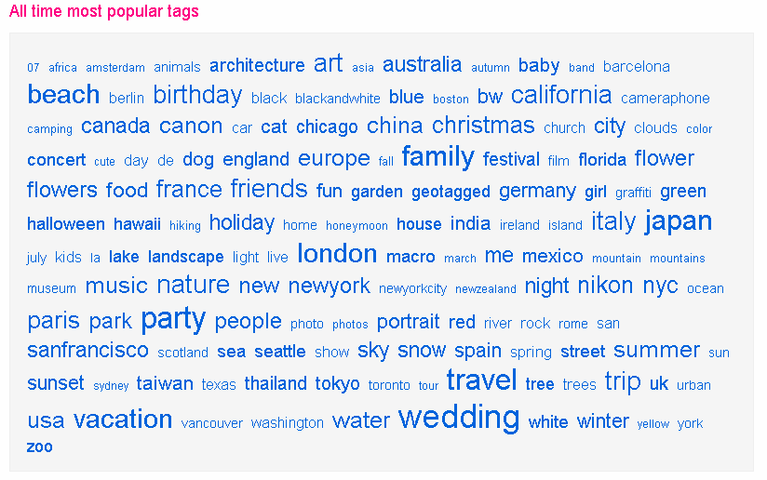
Flickr

Slide 17
Other Examples
Open Source Software
del.icio.us – Social bookmarking via tagging
Wikipedia – When crowdsourcing becomes collective intelligence
Digg Visualizations

Slide 18
Now, Try it...
Think and find an on-line demonstration about collective intelligence
  Present to all your classmates after 20 minutes by team

